Slide 1
Technological University(Meiktila)
Department for Information Technology
Information of Teachers in TU (Meiktila)
(final Seminar)
24-8-2023
Supervised By Dr. Myat Thu Aye
Project Group VI

Slide 2
Members of OUR TEAM
Lwin Aung
Han Htal Wint
Wa Thone Kyaw
V-IT-22
V-IT-23
V-IT-27

Slide 3

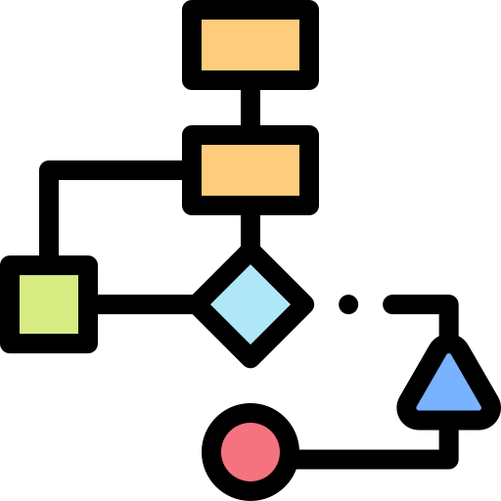






Outlines Of Presentation
Introduction
Flow Diagram
Abstract
Requirements
Objective
Project Structure
Background Theories
Summary

Slide 4
INTRODUCTION
Personal Information for Teachers in TU (Meiktila) is used to retrieve people information and personal data easily . It shows a variety information such as people's ID , parents name, parents ID and necessaries for personal affairs .
It is the exciting time at the People Personal Information for Teachers in TU (Meiktila) . At the leading of provider of data , People Information Directory is responding to change in Technology , to provide data to HR (Human Resource) with an effortless easy steps .

Slide 5
ABSTRACT
This system can reduce the counts that the employes had to fill out their personal information every time that the HR and office asked for it .
This is wanted to be easy in the modern internet era , saving time and not having to fill it out repeatedly the personal data by employee.
This system can send a notification message to the employee whenever it needs an update data.
This system can also reduce valuable time and save the word by reducing the use of papers .

Slide 6
Objectives
To improved data quality.
To increased operational efficiency.
To get real time data from the employee. By using this anyone can check in real time by using digital data form .
To get better data access. Re-entering data from paper forms can take hours or even days. With a digital solution, data is available in real-time. The Admin of HR can access the data more than a paper.

Slide 7
To reduce costs. Paper document management and archiving can be an intensive and expensive work.​
To get more reliable backups. improves the ability to properly backup all content and ensure that they can readily retrieve it.​

Slide 8
BACKGROUND THEORY
Background idea of the system​
React.js​
Node.js

Slide 9
Background Idea of the System
The background idea of a Personal Information for Teachers in TU (Meiktila) system is rooted in the need for individuals and organizations to manage and organize their personal data. This system is designed to provide a central repository for storing, organizing, and accessing a wide range of data.
One of the key theories behind the system is the idea of a "digital memory" or "digital brain."
The goal of these system is to provide users with a comprehensive, organized, and easily accessible repository for all of personal data . This allows users to more effectively manage their data and reduces the risk of data loss or duplication.

Slide 10
React.js is a JavaScript library for building user interfaces. It was developed and is maintained by Facebook.​
React is based on a component-based approach to building user interfaces, the use of a virtual DOM for efficient updates and rendering, and a declarative syntax for easier understanding and development.​
React.js

Slide 11
Node.js
Node.js is based on its use of Google's V8 JavaScript engine, its event-driven, non-blocking I/O model, and its large and growing ecosystem of modules and libraries. These features make it a fast, efficient, and scalable platform for server-side programming in JavaScript.

Slide 12






Requirements
Frontend | Backend | DATABASE | System Requirements
React.js | Node.js | Mongo DB | Window 8 , 10 ,11
Next.js | Express.js |  | Minimum core i3, 7 gen , Ram 4

Slide 13
Configuration:
1. Environment Variables: Store configuration files to manage different environments(development, production, etc.).
2. Constants: Define constants like API URLs, configuration settings.
2. Documentation:
1. Create a folder to hold documentation related to the IMS.
2. API Documentation: Document the API endpoints, request, and response payload.
3. Installation/Deployment Guide: Include instructions for setting up the system and
deploying it.
3. Utility:
1. Store utility or helper functions that are used throughout the system.
1.Dependencies:
1. Store any external dependencies, libraries, or modules required for the project.

Slide 14
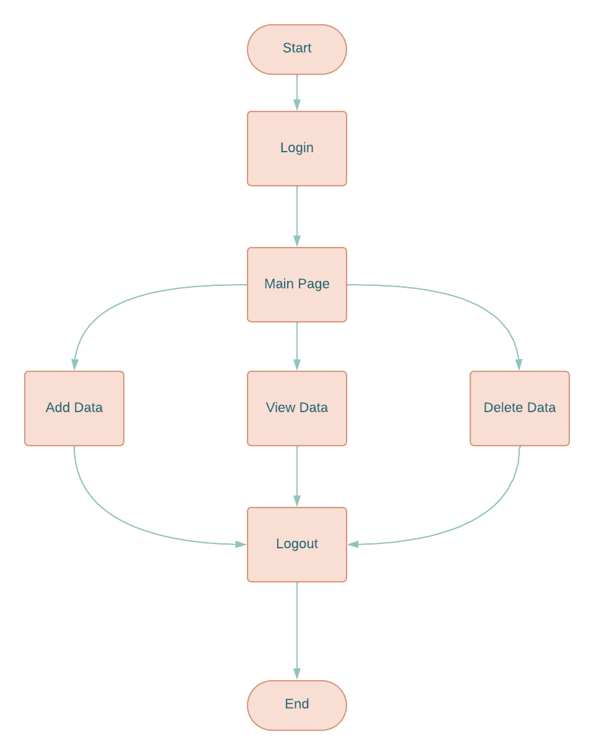
Flow Diagram
For Admin

Slide 15
Project structure
Main Project Directory
Backend
1. Controllers: Contains the logic to handle requests, process data, and interact with the database.
2. Models: Define data structures and interact with the database.
3. Views: In case the backend generates views.
4.Routes: Define the API endpoints and route requests to appropriate controllers.

Slide 16
Project structure
3.Fronted​
1. Components: Divide the frontend into reusable components for better organization.​
2. Views: Contains pages or templates that use components to display information.​
4.Database:​
1. Set up a directory or subdirectories to manage database-related files.​
2. Migrations: Store database schema migration files. ​

Slide 17
Step by step process

Slide 18
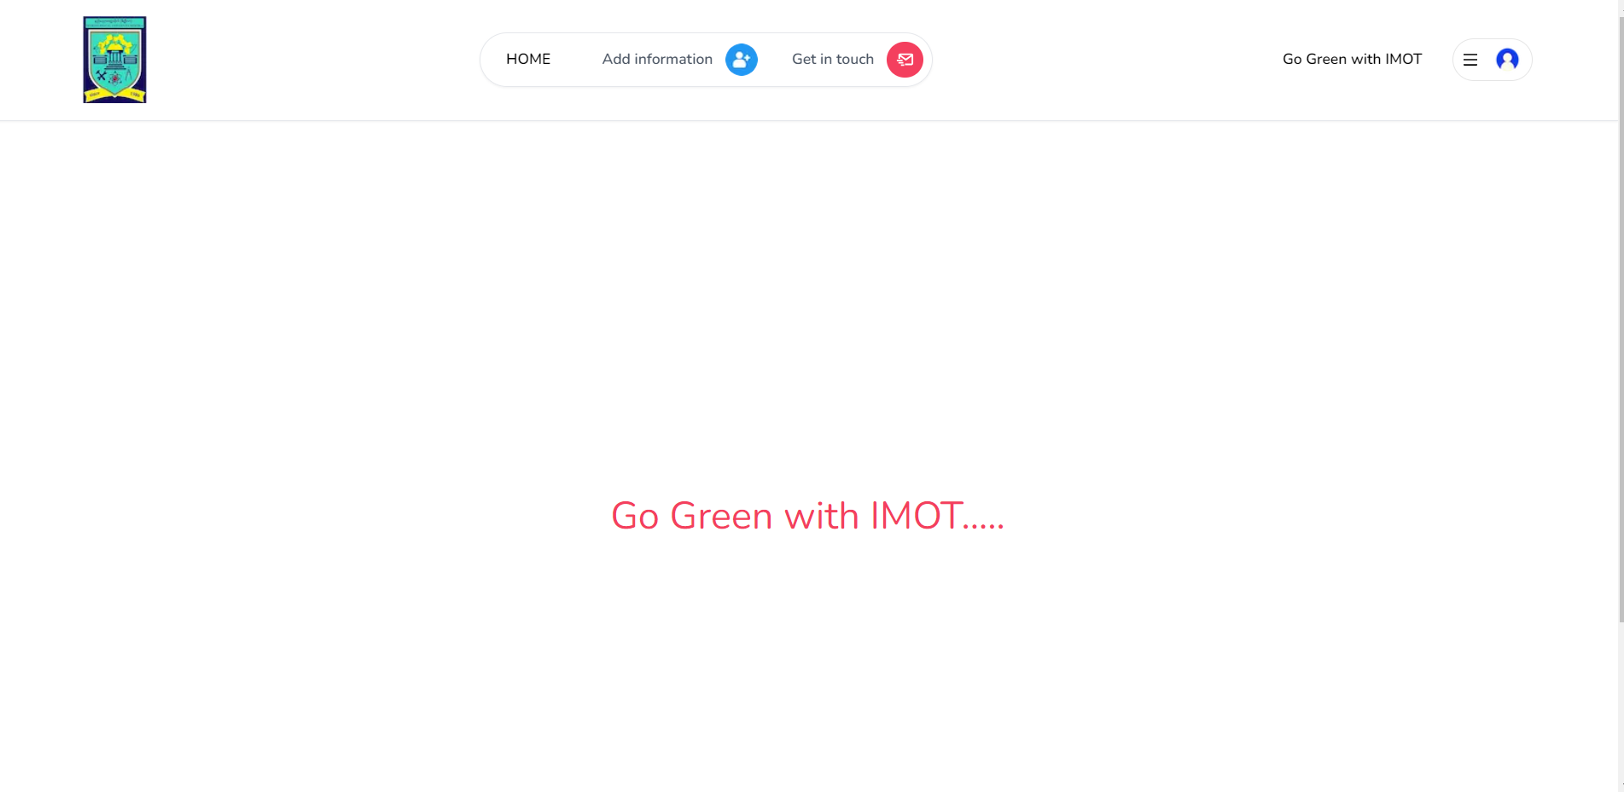
Figure: Main Page of the system

Slide 19
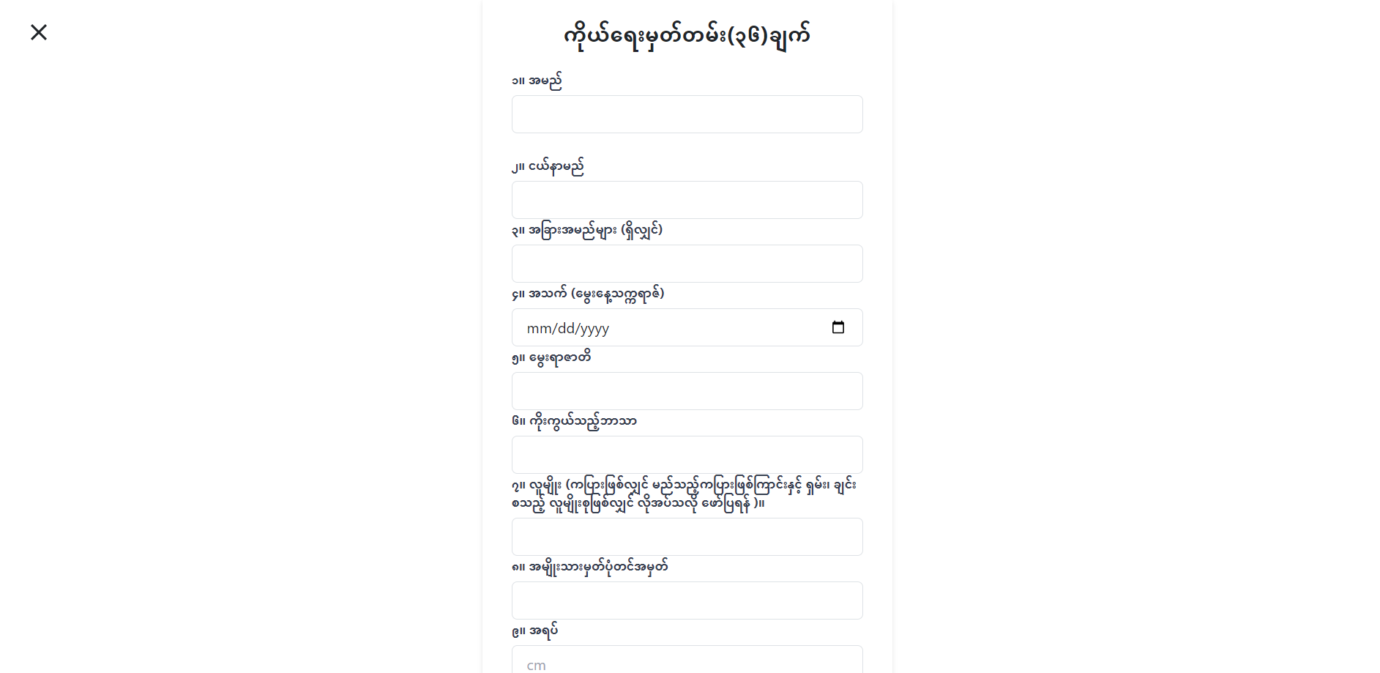
Figure: Fill personal data pgae

Slide 20
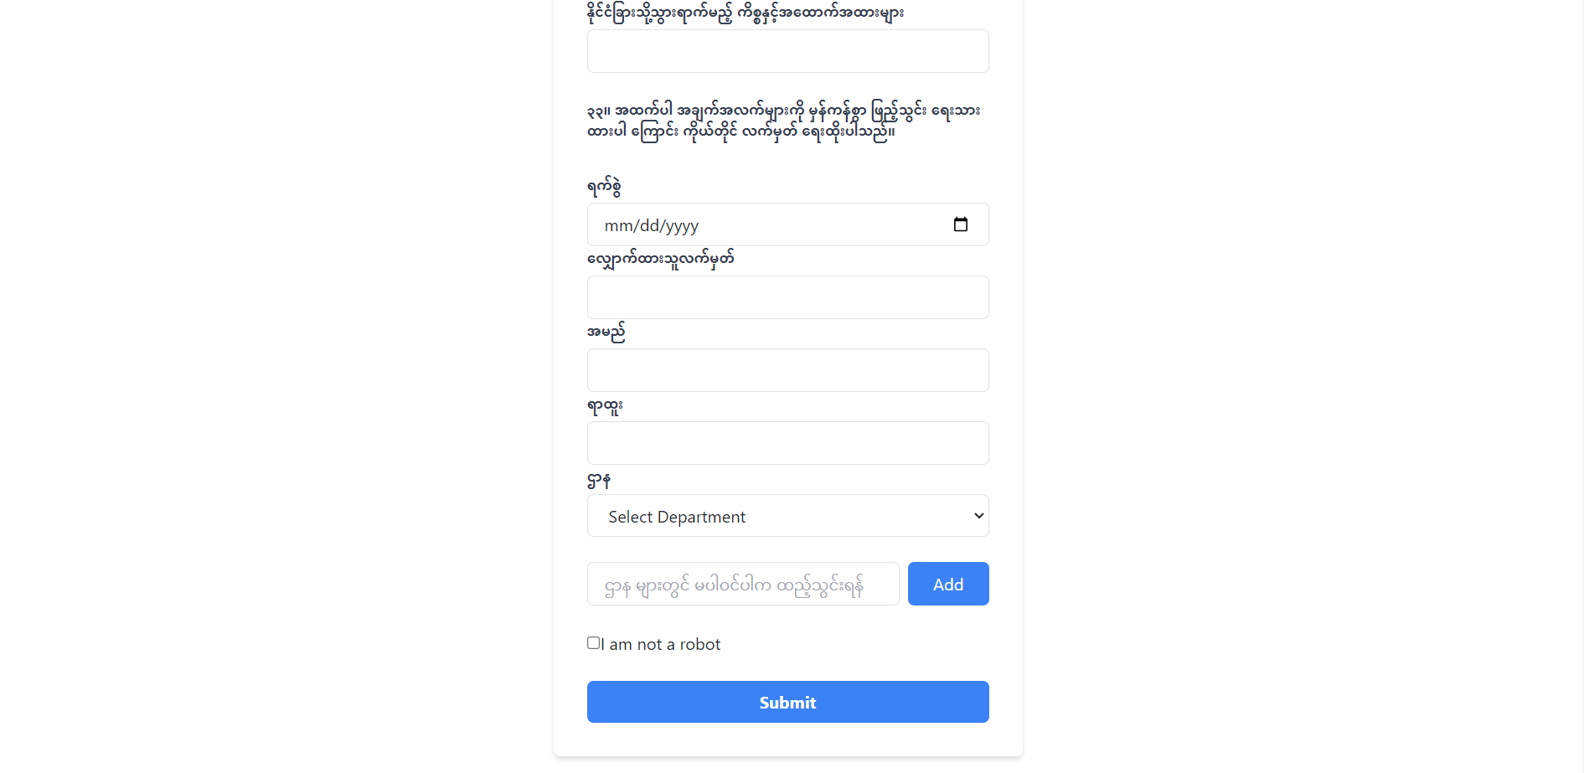
Figure: Fill personal data page

Slide 21
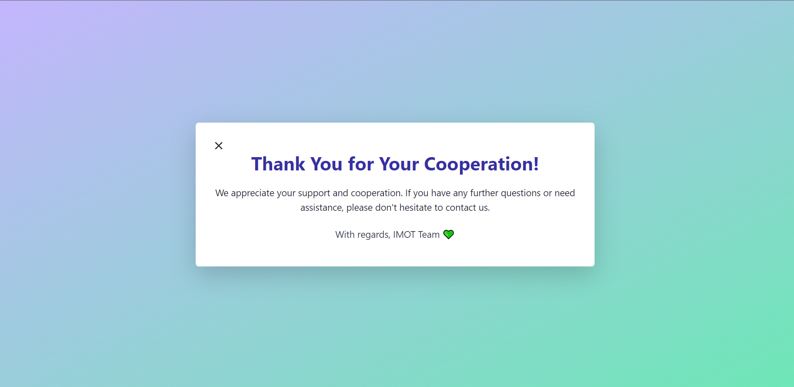
Figure: Feedback from the system

Slide 22
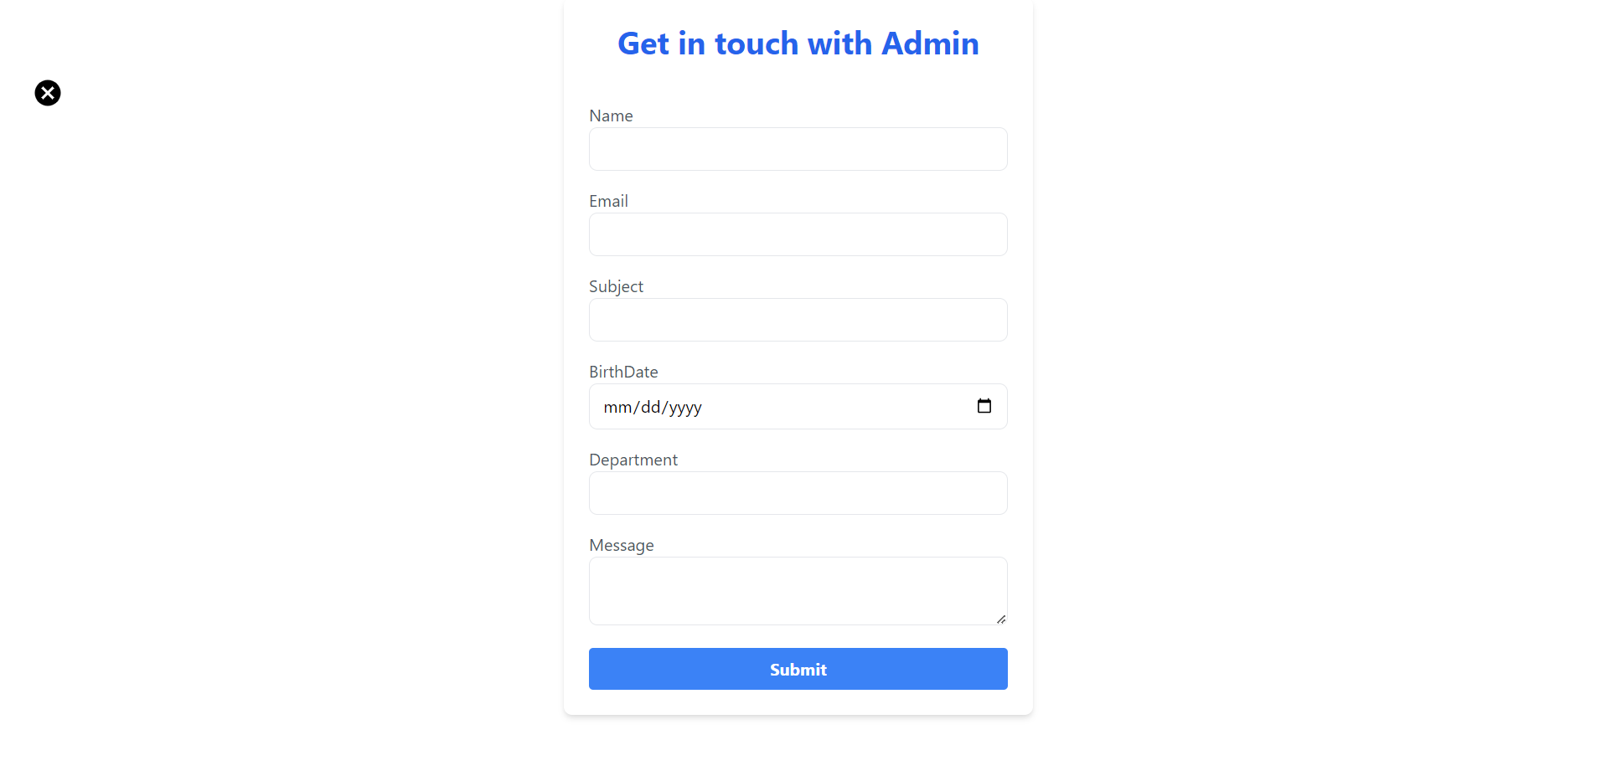
Figure: Get in touch with admin

Slide 23
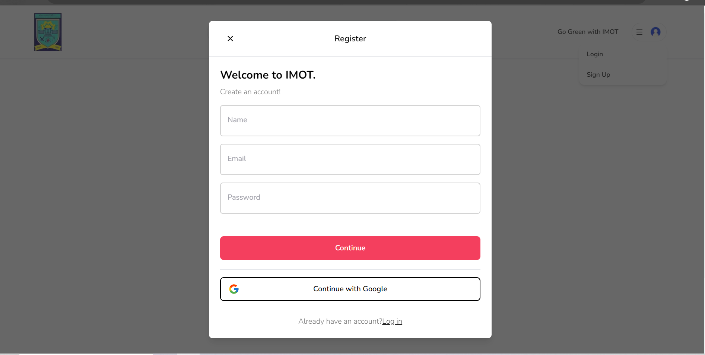
Figure: Admin Register page

Slide 24
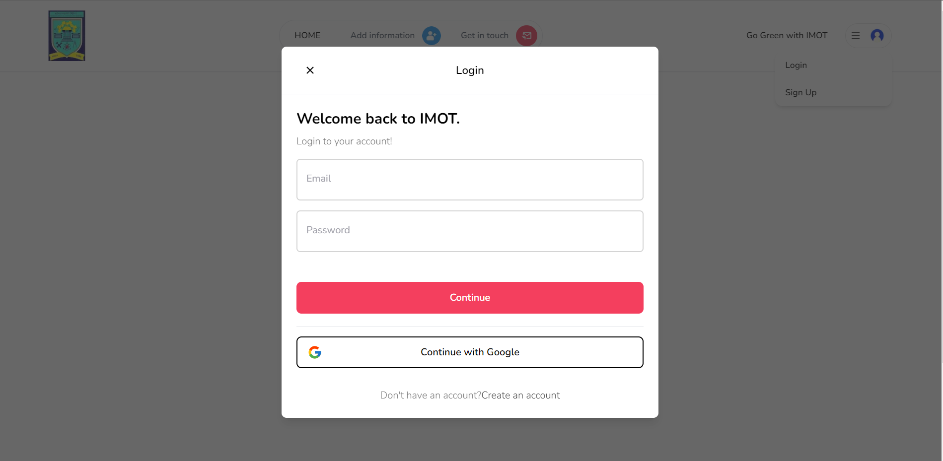
Figure: Admin Login page

Slide 25
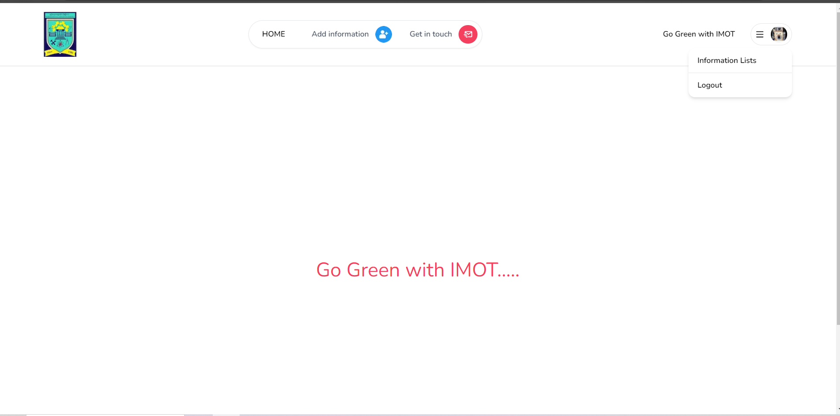
Figure: Admin profile

Slide 26
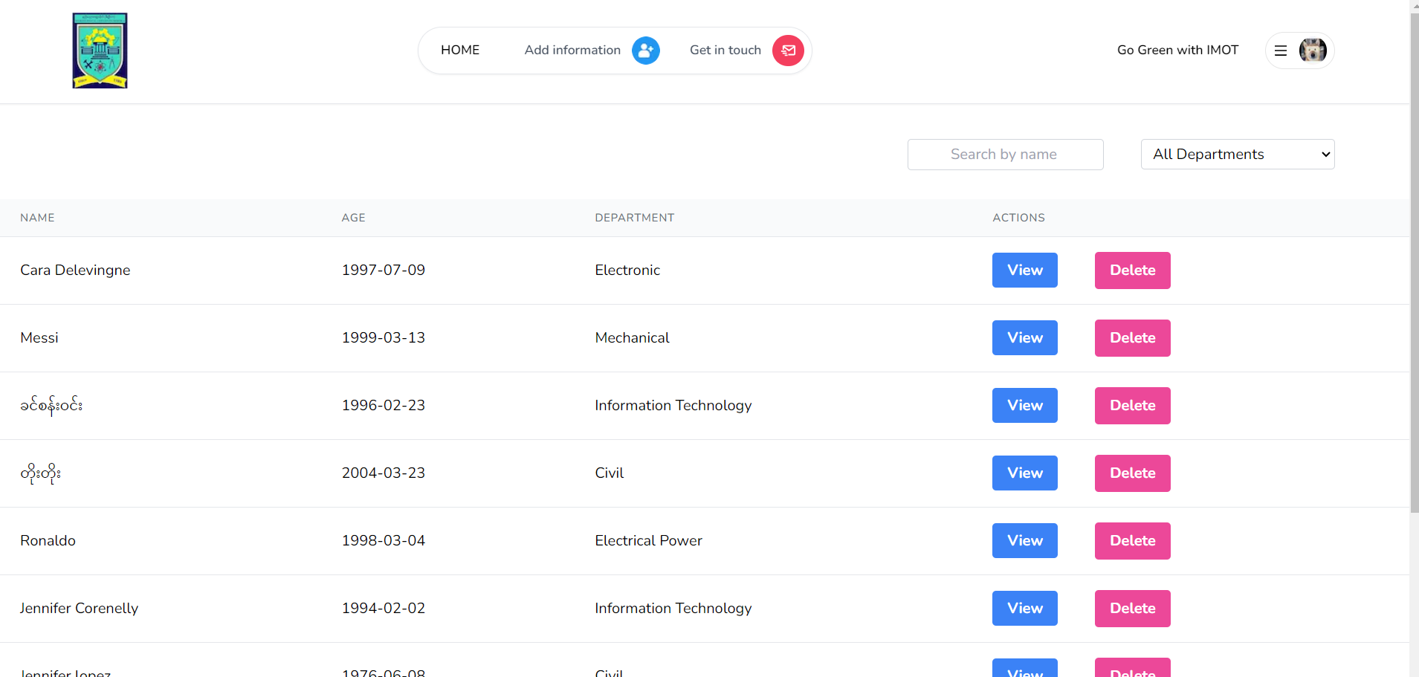
Figure: Data Lists

Slide 27
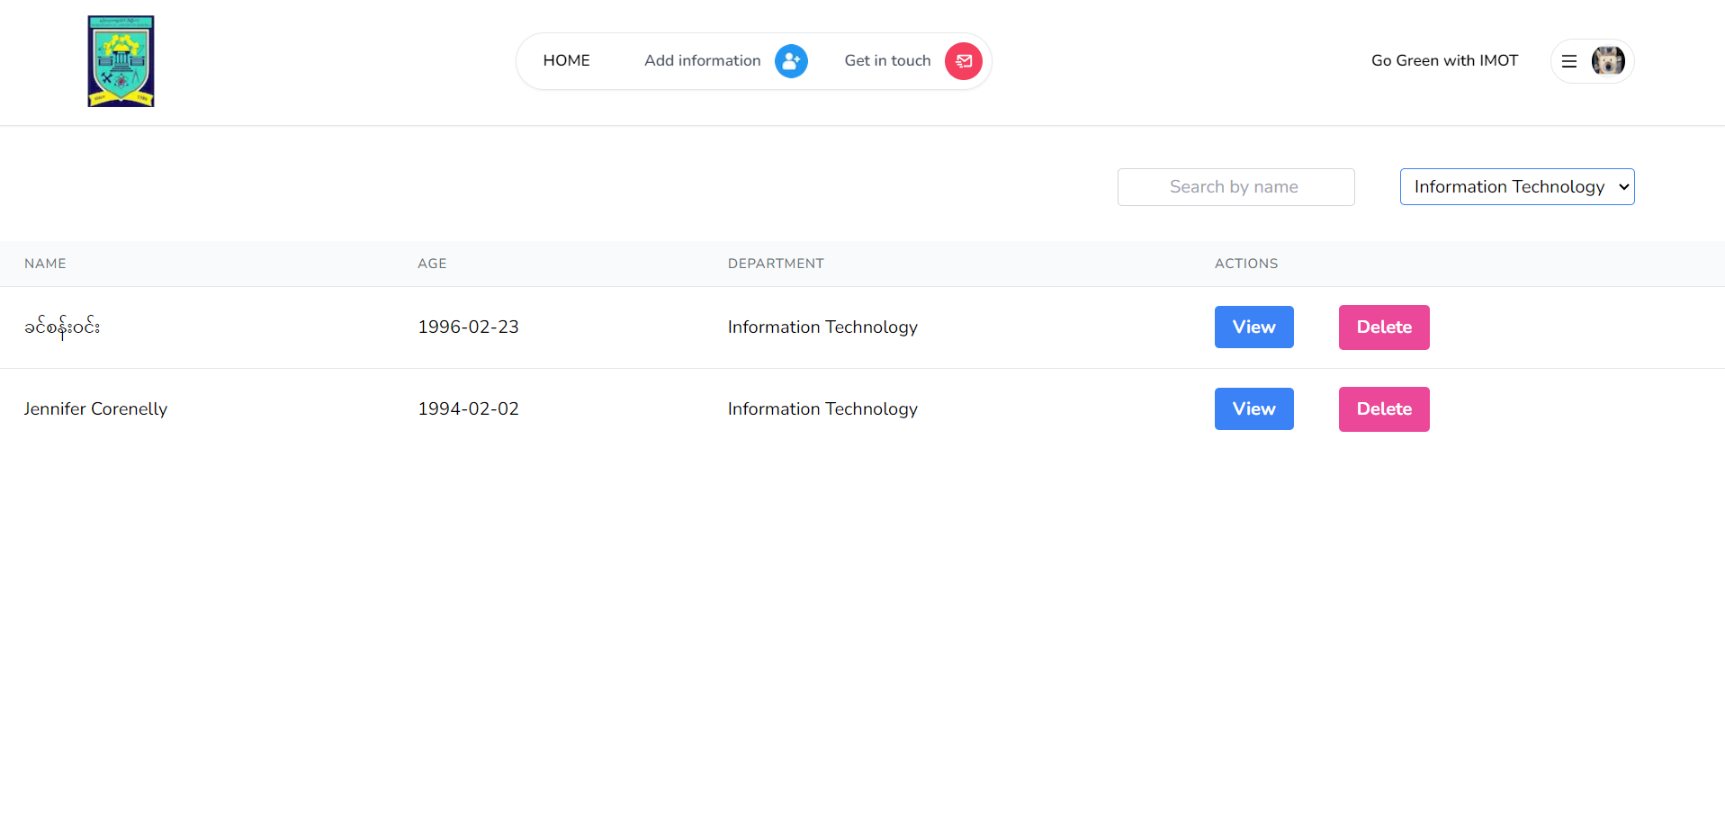
Figure: Filter data

Slide 28
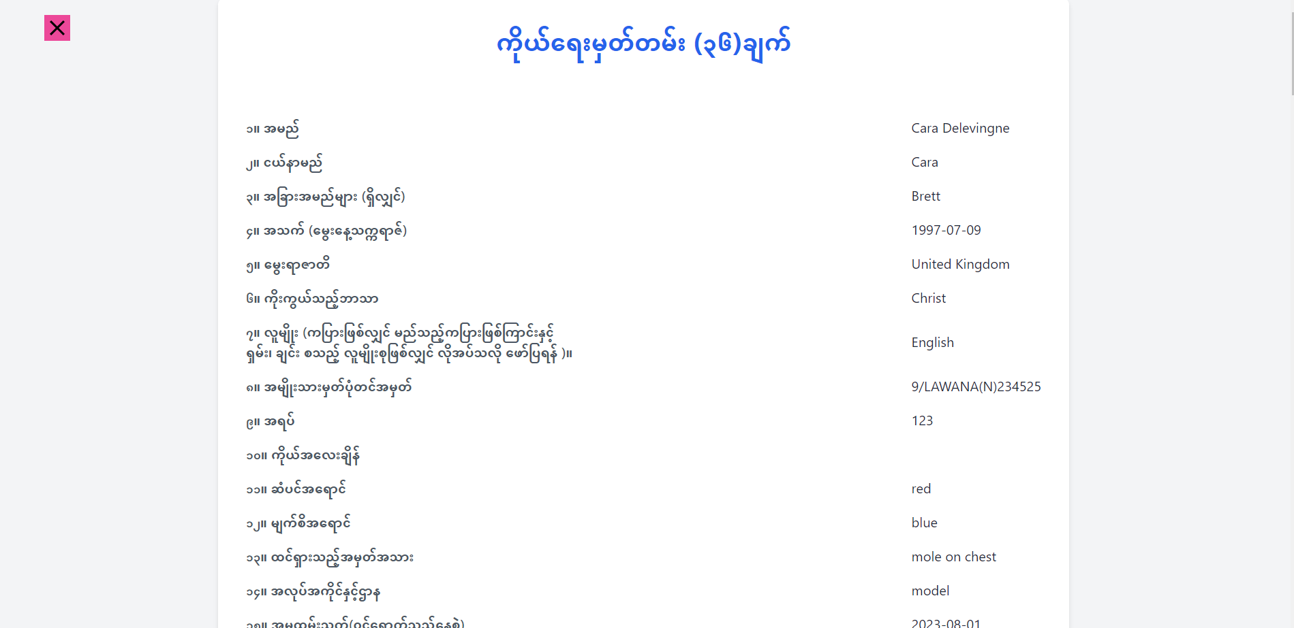
Figure: CV36

Slide 29
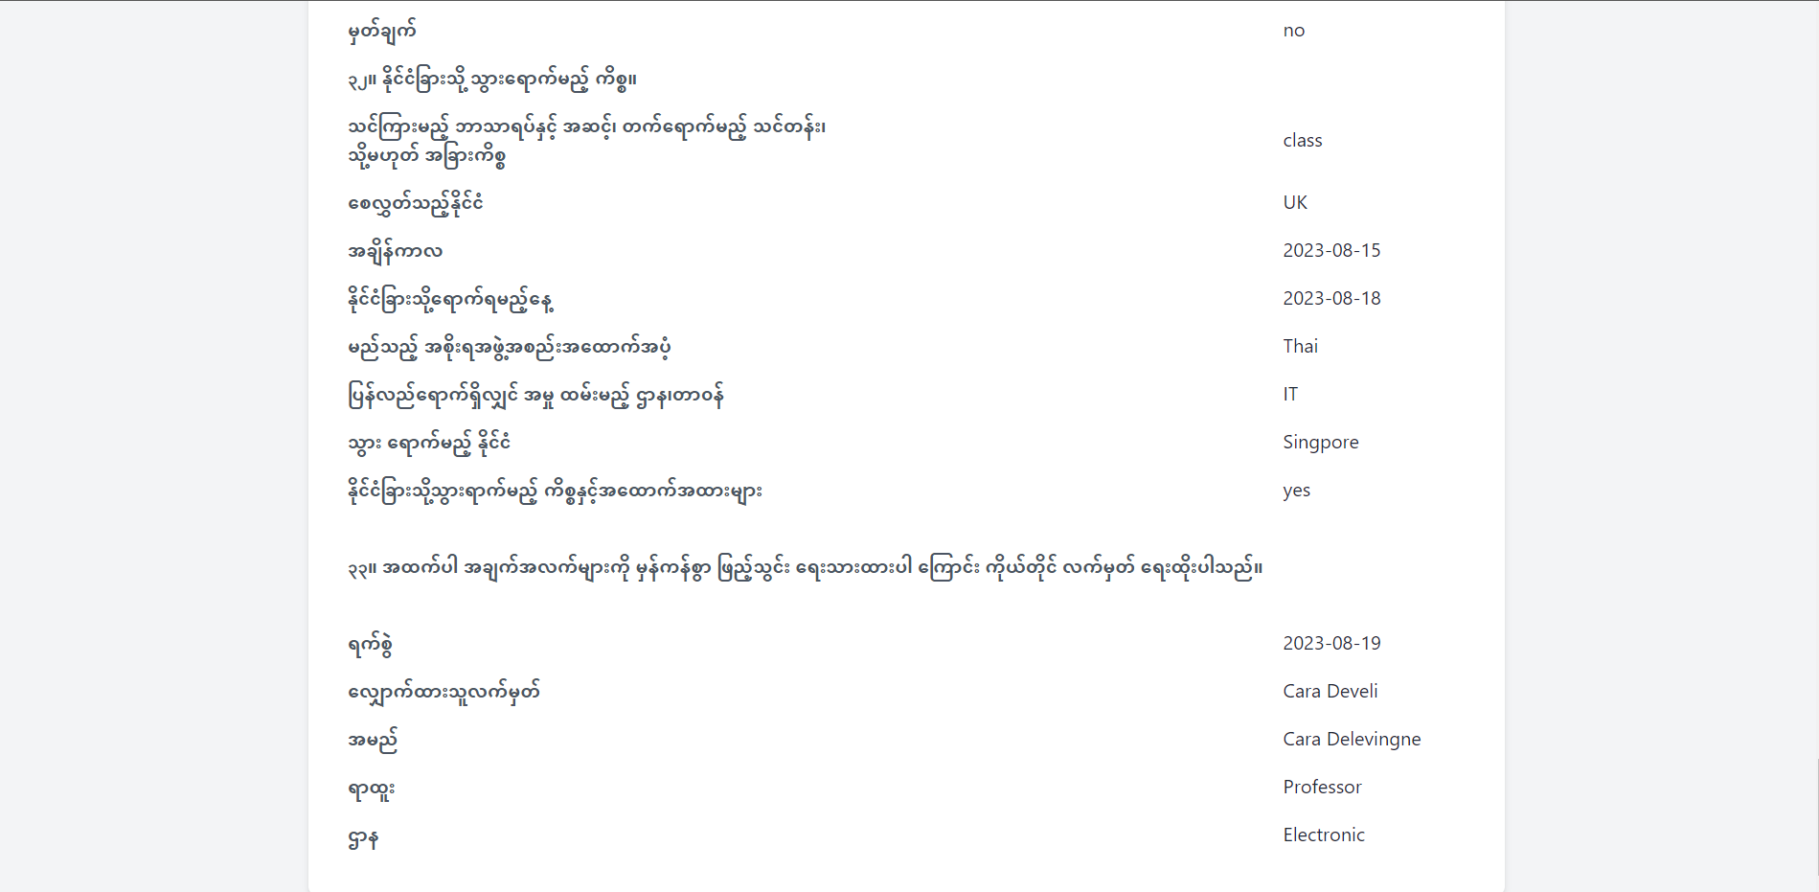
Figure: CV36

Slide 30
SUMMARY
This Personal Information for Teachers in TU (Meiktila) can help an admin to search and look out for information under digital platform , from personal ID to any other requirements for the personal information.
HR admin can easily get the information data with an effortless with this system .

Slide 31

THANK YOU

